Slide 1
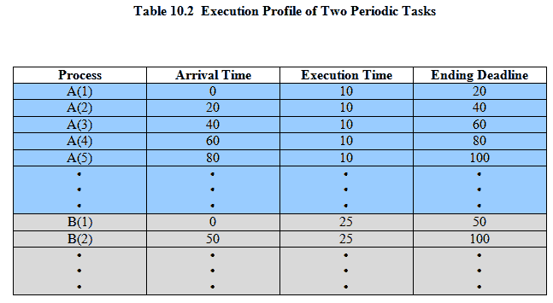
Create a Space/Time Diagram Prio A,B
Notes:
Movie icon links to animation of Periodic with Completion Deadline: http://gaia.ecs.csus.edu/%7ezhangd/oscal/pdeadlineschedulingperiodic.html
As an example of scheduling periodic tasks with completion deadlines, consider a system that collects and processes data from two sensors,A and B.
The dead-line for collecting data from
sensor A must be met every 20 ms,
for B every 50 ms.
It takes 10 ms, including operating system overhead, to process each sample of data from A
and 25 ms to process each sample of data from B.
Table 10.2 summarizes the execution profile of the two tasks.

